Slide 1

IBM – Coursera Data Science Specialization
Capstone project - Final report
Correlation between a neighborhood real estate price and its surrounding venues

Slide 2

Table of content:
I. Introduction
II. Data description:
III. Methodology:
1. First insight using visualization
2. Linear Regression
3. Principal Component Regression (PCR)
IV. Results
V. Discussion
VI. Conclusion

Slide 3
I. Introduction:
This report is for the final course of the Data Science Specialization. A 9-courses series created by IBM, hosted on Coursera platform.
The problem and the analysis approach are left for the learner to decide, with a requirement of leveraging the Foursquare location data to explore or compare neighborhoods or cities of your choice or to come up with a problem that you can use the Foursquare location data to solve.
The main goal will be exploring the neighborhoods of New York city in order to extract the correlation between the real estate value and its surrounding venues.

Slide 4
So, can the surrounding venues affect the price of a house? If so, what types of venues have the most affect, both positively and negatively?
The target audience for this report are:
- Potential buyers who can roughly estimate the value of a house based on the surrounding venues and the average price.
- Real estate makers and planners who can decide what kind of venues to put around their products to maximize selling price.
- Houses sellers who can optimize their advertisements.
- And of course, to this course’s instructors and learners who will grade this project. Or to anyone who catch this shared on the social media showing that I can use Python data science tools.

Slide 5
II. Data description:
New York city neighborhoods were chosen as the observation target due to the following reasons: - The availability of real estate prices. Though very limited. - The diversity of prices between neighborhoods. For example, a 2-bedrooms condo in Central Park West, Upper West Side can cost $4.91 million on average; while in Inwood, Upper Manhattan, just 30 minutes away, it's only $498 thousands. - The availability of geo data which can be used to visualize the dataset onto a map.
The type of real estate to be considered is 2-bedroom condo, which is common for most normal nuclear families.

Slide 6
The dataset will be composed from the following two main sources: - CityRealty which provides the neighborhoods average prices. https://www.cityrealty.com/nyc/market-insight/features/get-toknow/average-nyc-condo-prices-neighborhood-june-2018/18804 - FourSquare API which provides the surrounding venues of a given coordinates.
The process of collecting and clean data:
- Scrap the CityRealty webpage for a list of New York city neighborhoods and their corresponding 2-bedroom condo average price.
- Find the geographic data of the neighborhoods. Both their center coordinates and their border.
- For each neighborhood, pass the obtained coordinates to FourSquare API. The “explore” endpoint will return a list of surrounding venues in a predefined radius.
- Count the occurrence of each venue type in a neighborhood. Then apply one hot encoding to turn each venue type into a column with their occurrence as the value.
- Standardize the average price by removing the mean and scaling to unit variance.

Slide 7
III. Methodology:
The assumption is that real estate price is dependent on the surrounding venue. Thus, regression techniques will be used to analyze the dataset. The regressors will be the occurrences of venue types. And the dependent variable will be standardized average prices.
At the end, a regression model will be obtained. Along with a coefficients list which describes how each venue type may be related to the increase or decrease of a neighborhood’s real estate average price around the mean.
Python data science tools will be used to help analyze the data. Completed code can be found here: https://github.com/lethien/coursera-ibm-dscapstone/blob/master/Capstone_Analyze.ipynb

Slide 8
1. First insight using visualization:
In order to have a first insight of New York city real estate average price between neighborhoods, there is no better way than visualization.
The medium chosen is Choropleth map, which uses differences in shading or coloring to indicate a property’s values or quantity within predefined areas. It is ideal for showing how differently real estate priced between neighborhoods across the New York city map.
The map (Figure 2) shows high price in neighborhoods that located around Central Park, Midtown and Lower Manhattan. The price reduces further toward North Manhattan or toward Brooklyn.
Manhattan can be considered the heart of New York city. It’s where most businesses, tourist attractions and entertainments located. So, the venue types that can attract many people are expected to have the most positive coefficients in the regression model.

Slide 9
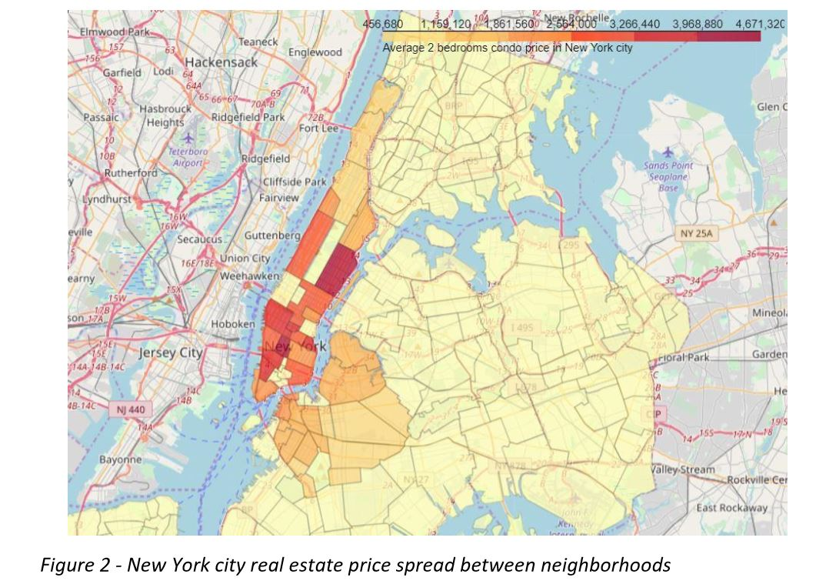

Slide 10
2. Linear Regression:
Linear Regression was chosen because it is a simple technique. And by using Sklearn library, implementing the model is quick and easy. Which is perfect to start the analyzing process.
The model will contain a list of coefficients corresponding to venue types. R2 score (or Coefficient of determination) and Mean Squared Error (MSE) will be used to see how well the model fit the data.
The result (Figure 3) doesn’t seem very promising. R2 score is small, which means the model may not be suitable for the data.

Slide 11
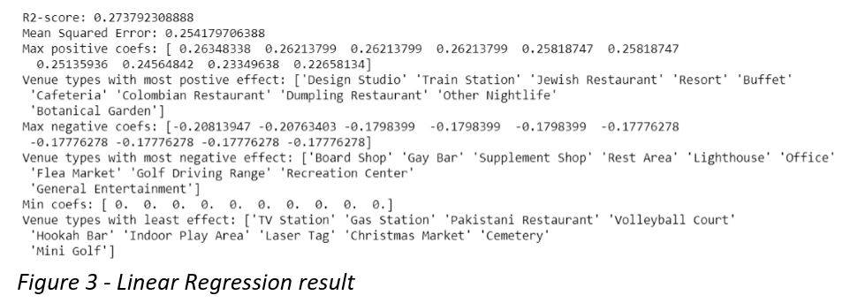
But on the bright side, the coefficient list shows some interest and logical information: - “Studios” and “Eateries” both mean businesses. “Train Station” means ease of transportation. All of which usually increase the value of a location. - “Bar” and “Market” sure are nice to visit sometimes but may not be a suitable neighborhood for family with kids. “Lighthouse” and “Golf” usually located in the rural areas. The demand for such locations is usually low. - “TV station”, “Cemetery”, “Laser Tag”, “Mini Golf” all give value to a limited range of people. “Gas Station” is available everywhere. These types of venue usually are not dicision factor when considering a location.

Slide 12
3. Principal Component Regression (PCR):
PCR can be explained simply as the combination of Principal Component Analysis (PCA) with Linear Regression. (Wikipedia, n.d.)
PCR employs the power of PCA, which can convert a set of values of possibly correlated variables into a set of values of linearly uncorrelated variables called principal components. As the result, the number of features is reduced while keeping most of the characteristic of the dataset.
Then PCR use Linear Regression on the converted set to return a coefficient list, just like in normal Regression techniques.
Again, R2 score and MSE are used to see how well the model fit the dataset.

Slide 13
IV. Results:
Even though the scores seem to be improved after applying a more sophisticate method, the model is still not suitable for the dataset. Thus, it can’t be used to precisely predict a neighborhood average price.
Explanations for the poor model can be: - The real estate price is hard to predict.
- The data is incomplete (small sample size, missing deciding factors).
- The machine learning techniques are chosen or applied poorly.
But again, on the bright side, the insight, gotten from observing the analysis results, seems consistent and logical. And the insight is business venues that can serve the needs of most normal people usually situated in pricy neighborhoods.

Slide 14
V. Discussion:
The real challenge is constructing the dataset:
- Usually the needed data isn’t publicly available.
- When combining data from multiple sources, inconsistent can happen. And lots of efforts are required to check, research and change the data before merge.
- For data obtained through API calls, different results are returned with different set of parameters and different point of time. Multiple trial and error runs are required to get the optimal result.
- Even after the dataset has been constructed, lots of research and analysis are required to decide if the data should be kept as is or be transform by normalization or standardization.

Slide 15
VI. Conclusion:
It’s unfortunately that the analysis couldn’t produce a precise model or showing any strong coefficient correlation for any venue type. But we can still get some meaningful and logical insights from the result.
Doing this project helps practicing every topic in the specialization, and thus, equipping learners with Data Science methodology and tools using Python libraries. Also doing a real project certainly helps one learns so much more outside the curriculum, as well as realizes what more to research into after completing the program. And as this report shows, there are surely a lot of things to dig into.
Some notes on the analysis result:
- This project is done by a web developer who only started self-studying Data Science for 4 months. So please take it with a grain of salt.
- The coefficients only show correlation, not causation. So, if your neighborhood average price is low, please don’t go destroying the surrounding bars and food trucks. There might be another reason.
Toward the person that went through this project, many thanks for the time and patient.

Slide 16
References:
Wikipedia. (n.d.). Principal component regression. Retrieved from Wikipedia: https://en.wikipedia.org/wiki/Principal_component_regression

